Slide 1
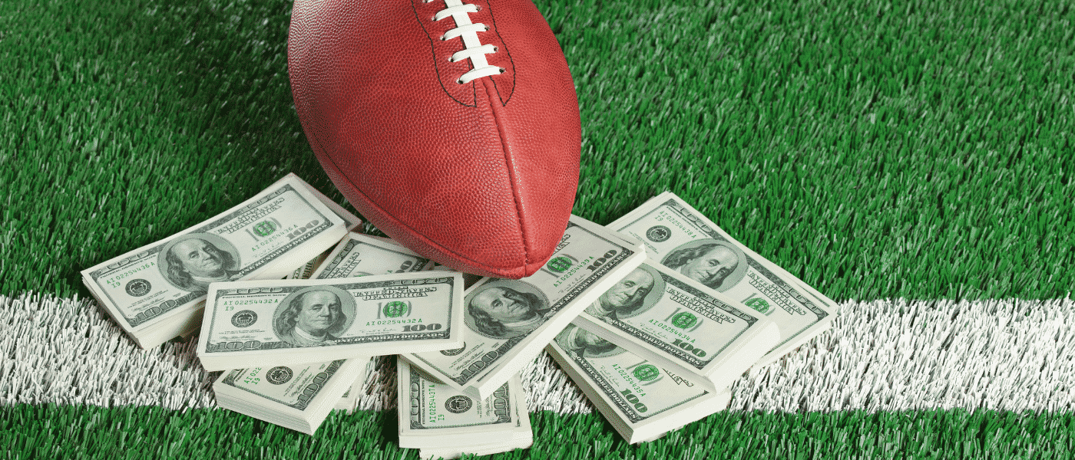
The Three Swamis
Scott Thomas
Ken Saville
Kirk Novak

Slide 2
Are you able to gain an advantage in football sports gambling using data analysis?
Historically speaking are certain teams better against the spread than others?
Does weather affect score?
Based on temperature and/or windspeed?
Is over or under a safer bet?
When should I take the points?
Is there a home field advantage?

Slide 3
NFL scores and betting data from Kaggle!!
Dataset included game results since 1966 with betting odds since 1979.
Started with 12,917 rows and 17 columns
season year
home and away team include scores
favorite, point spread, over/under line
weather conditions

Slide 4
Data cleanup & exploration
Filtered data for after 1979
Pre 1979 didn’t have point spreads
Dropped all N/A’s
Most N/A’s didn’t have weather information
Dropped other columns not necessary for our analysis
Changed column data types to accommodate analysis
Merged team names for consistency
e.g. teams moving cities
Created new columns:
Total score for O/U analysis
O/U column for pass/fail/push
Spread difference
Cover pass/fail/push
Game score total difference
Score categories
Made initial exploratory plots

Slide 5
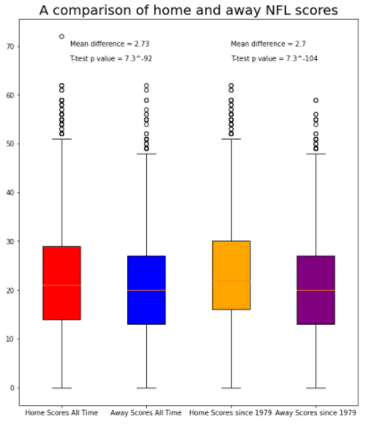
Is there a home field advantage?
Title for graph
Compares home vs away score all time and home vs away scores since 1979
graph
Yes, there is a home field advantage.
The mean difference all time is 2.73 points and the mean difference since 1979 is 2.7.
Bookmakers adjust their line in favor of the home team by 3 points before any other adjustment is made.

Slide 6
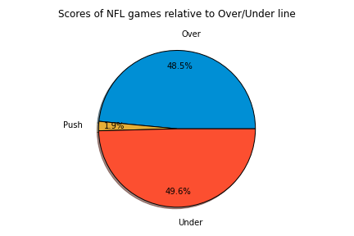
Is over or under a safer bet?
Title for graph
Compares total score to the O/U line
graph
No, the O/U isn’t a safer bet.
It’s a virtual coin flip; 49.6% to 48.5%.
Push is when the total score matches the O/U line.

Slide 7
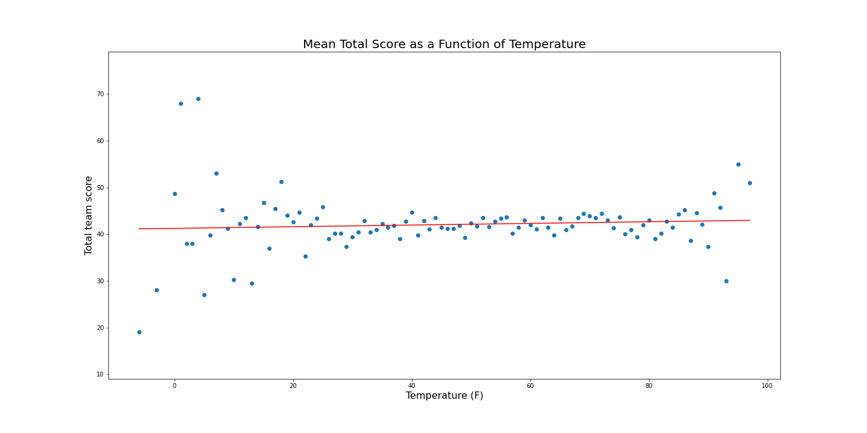
Does temperature affect score?
Title for graph
Compares mean total score vs temperature
graph
No, temperature doesn’t affect the total score.

Slide 8
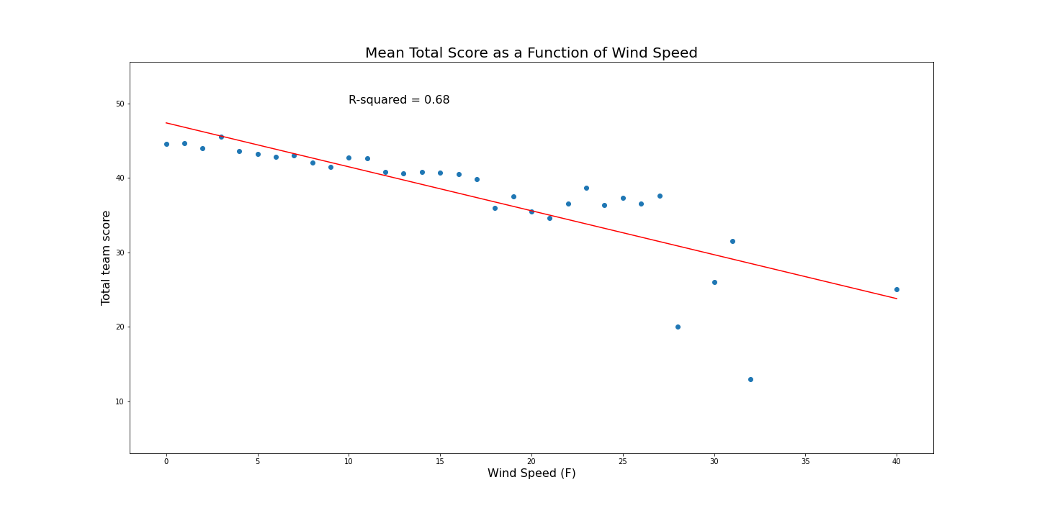
Does wind affect score?
Title for graph
Compares mean total score vs wind speed
graph
Yes, wind speed affects the score.
There is a negative correlation of 0.68.

Slide 9
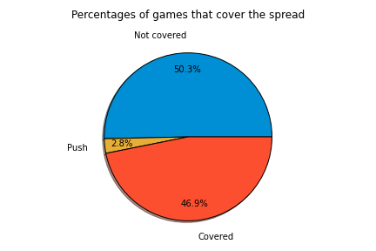
When should I take the points?
Compares the percentage of games that covered the spread vs not covered
Flip a coin!!!
Historical results don’t offer much help in determining when you should take the points.

Slide 10
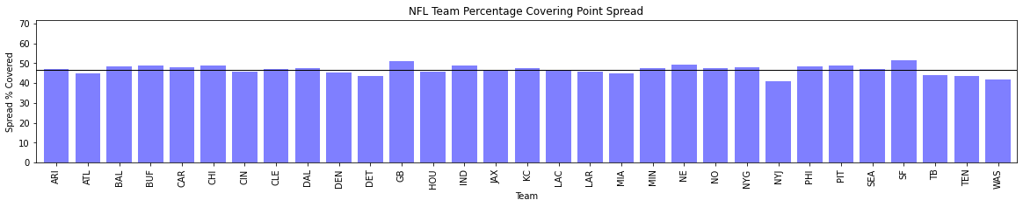
Historically speaking are certain teams better against the spread than others?
No, facts don’t care about your feelings.
Teams cover the spread 47% of the time.

Slide 11
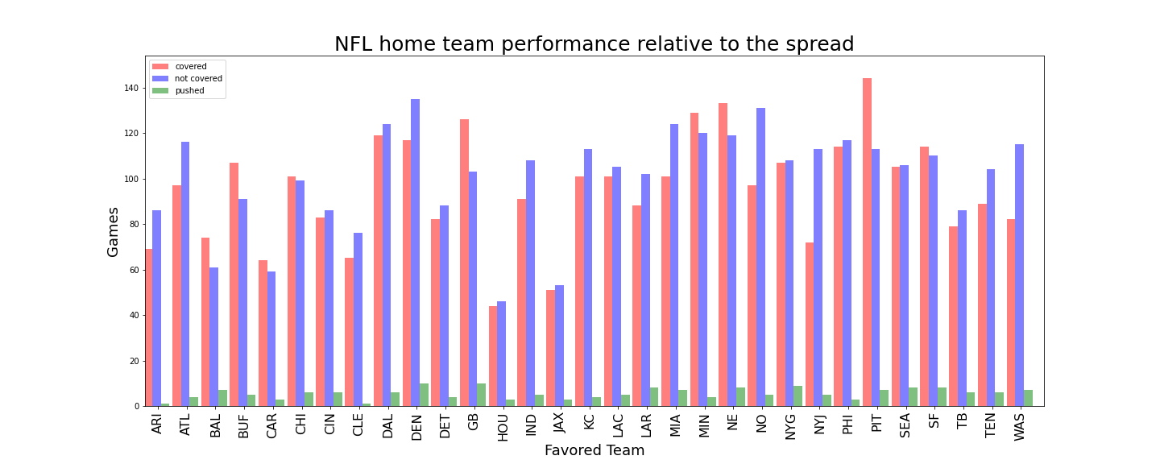
Historically speaking are certain teams better at home against the spread than others?
Yes, there are certain teams better at home against the spread than others.
But don’t bet on it!!

Slide 12
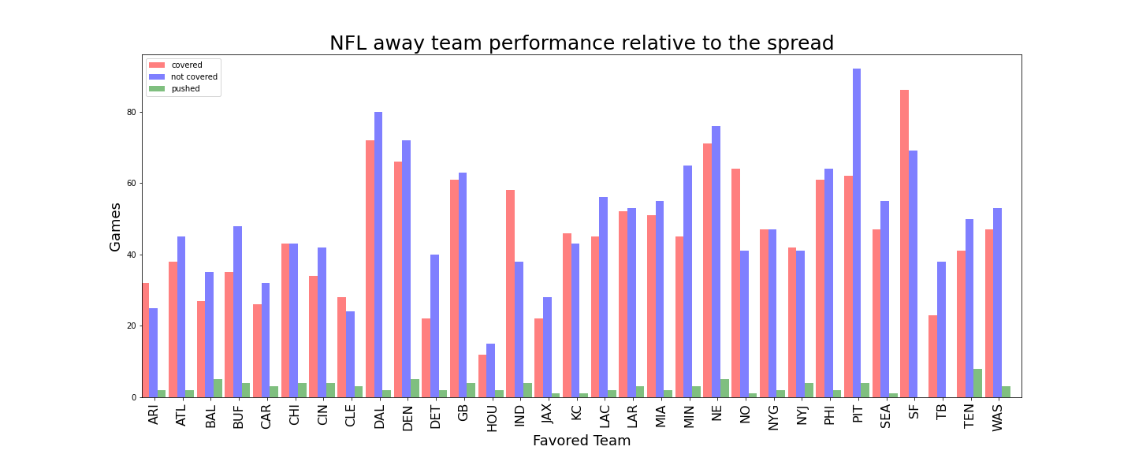
Historically speaking are certain teams better away against the spread than others?
Yes, there are certain teams better away against the spread than others.
But don’t bet on it!!

Slide 13
Discussion
Biggest takeaway is that the house is the only safe bet!
There are no big exploitable trends in the analysis.
Bookmakers already take all these factors into account, and probably a million others.

Slide 14
Post Mortem
The biggest difficulty was running analysis on multi-indexed data.
Additional data would be needed to increase your odds:
Starting QB
Time of game; east/west coast team playing in the other time zone
Bye weeks
Injuries of star players

Slide 15
Questions?

